Slide 1
Holistic Hiking
Clayton Brandt
Nathan McMichael
Terysa Brewer
Luke Bunting
William Pardue

Slide 2
Problem Statement
Hikers want a free, easy to use app that can be used without installation or setup, that allows them to find trails and interact with other hikers.

Slide 3
Stakeholders and Users
Stakeholders
Open-sourced code
Free/Ad-Free
Users
Application is intended for anyone who enjoys hiking
Experienced and novice hikers

Slide 4
Requirements Summary
Users can search for trails by different parameters
Users can browse trails
Users can view trail information retrieved from API

Slide 5
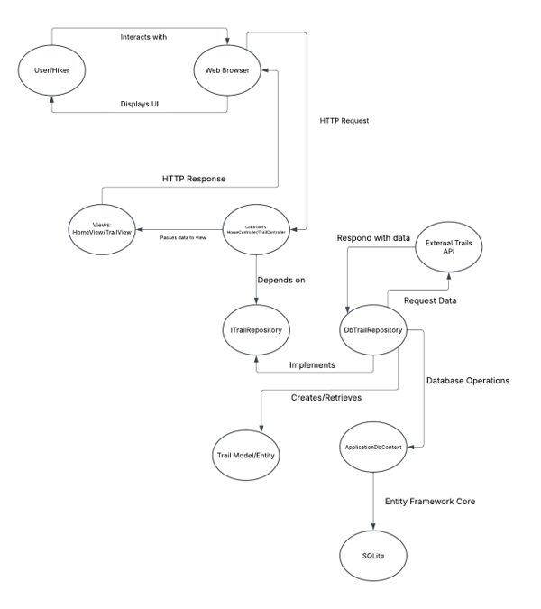
Architecture and Design
Uses an MVC Architecture

Slide 6
Technology Stack
ASP.NET MVC
C#
Entity Framework Core
SQLite
Bootstrap

Slide 7
Key Features
Trail browser displays information in a simple, eye-catching format
Mock-Up for Search and filter function to allow different parameters, including rating, length, and difficulty
User account creation and Sign-In

Slide 8
Live Demonstration

Slide 9
Testing and Quality Assurance
Consistent visual language
Updates to different screen sizes
Future testing:
  CRUD tests
  Search tests

Slide 10
Lessons Learned
Make sure to set up .gitignore correctly at the beginning
Clear division of labor
Make sure the API fits your needs

Slide 11
Future Enhancements
Add user account features
User bio page
Expand database to handle more user data
Users can rate trails
Trails' rating is displayed
Users can comment on trails
Add comment tab to trail info page

Slide 12
Any Questions?

